Slide 1

Designing Gov’t Transformation
Why delivery is not enough
2021 Dotgov Design Conference
Joy Bonaguro | Chief Data Officer | State of California
@joybonaguro | medium.com/@joybonaguro
Notes:
I was really excited to be invited to this keynote. Highlight what I think are very important policy tools that will help you in your gov’t work.

Slide 2

Why delivery is necessary but not sufficient

Slide 3
It’s too narrow: Government doesn’t deliver all the services - it does other stuff too
Direct service provider
Funder of services
Regulation
Research
* Distribution not to scale and varies by level of government

Slide 4

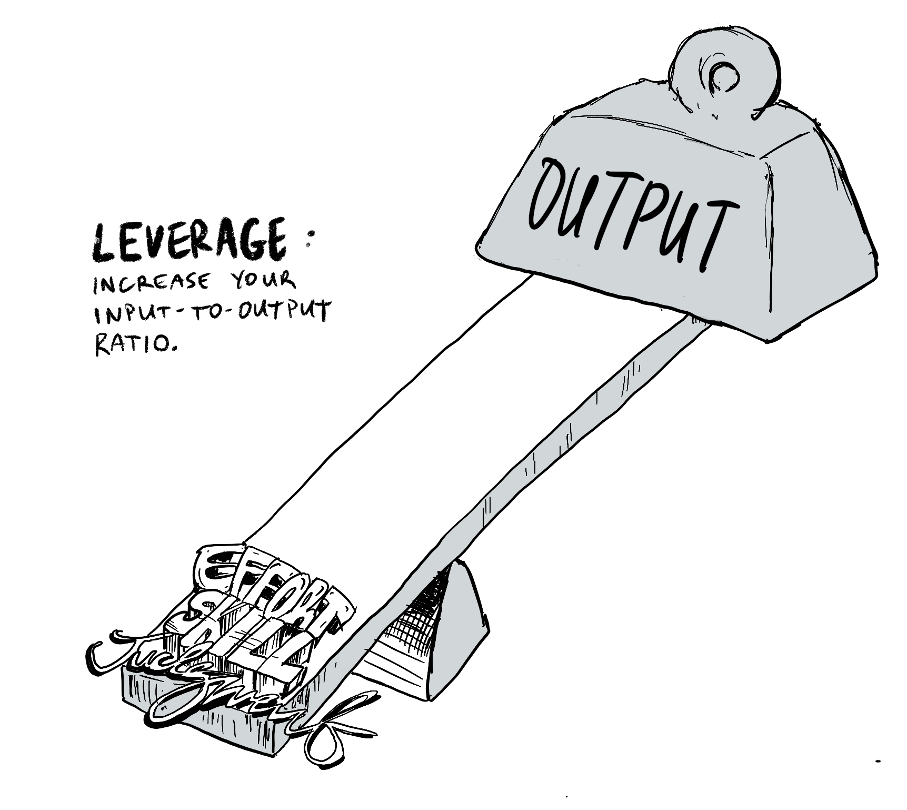
Lack of connective tissue between projects ignores the importance of leverage
Starting fresh every time is exhausting
Strategically linking projects is a booster
https://www.domo.com/blog/why-bi-leverage-matters-and-how-businesses-can-get-it/
Illustration by Andrew Yu

Slide 5

In gov’t everyone on the bus has a brake pedal

Slide 6

Toolkit to help you design a strategy for your bus(es)

Slide 7


Institutional stakeholders

Slide 8
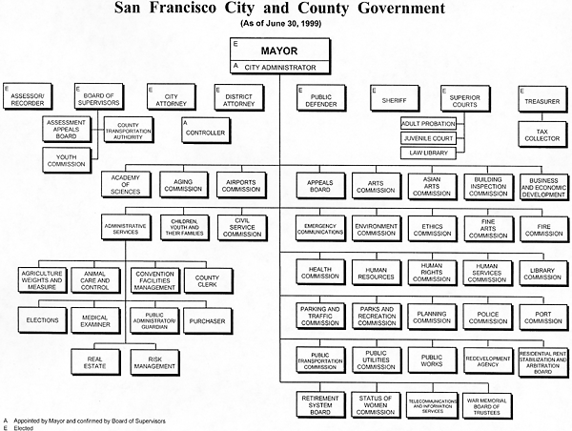
Diagnose and analyze where you sit
Design factors that flow from where you sit:
Your organization’s
History and reputation
Leverage and influence
Institutional friends (and enemies)
Your boss and their perceived tenure
Elected versus appointed versus civil service

Slide 9
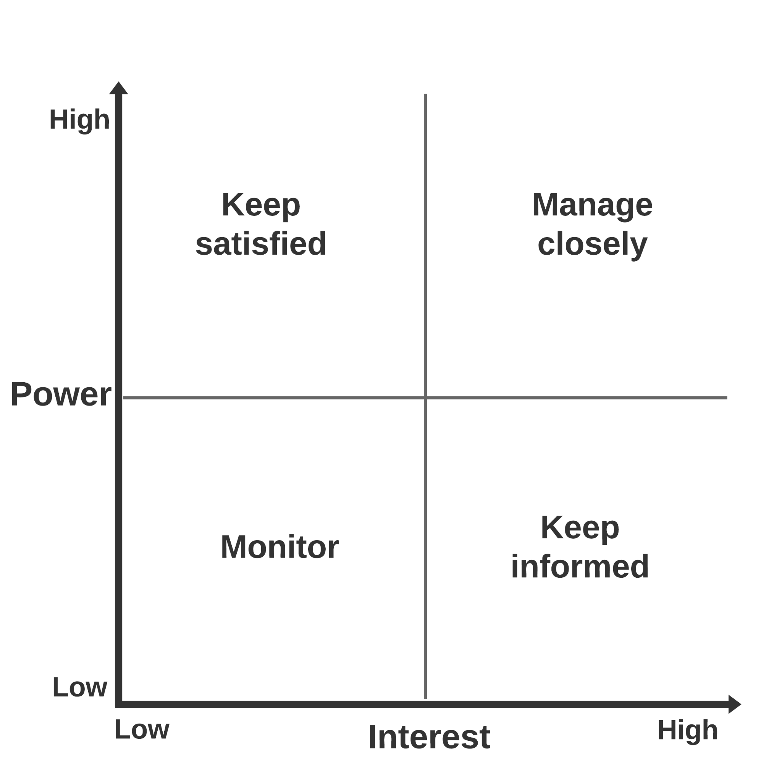
Map your stakeholders by level of interest and power

Slide 10
Use your stakeholder map to design your communications & engagement strategy
Stakeholder | Group | Strategy | Interests / priorities | Messages | Channel | Frequency
Boss | High Power / High Interest | Manage closely | x, y, z | We got it covered | 1.1’s | Biweekly
Important resource | High Power / Low Interest | Increase interest Or Keep satisfied | Homelessness | Here’s how we helped | Oh no! We have no way of reaching them!!!
Friendly org | Low Power / High Interest | Keep informed or Increase power | ...

Slide 11


A note on Institutional Rainmakers

Slide 12




Institutional roles have different functions and time horizons
Set agenda & priorities
Implement
Elected officials & appointees
Management
Civil service

Slide 13
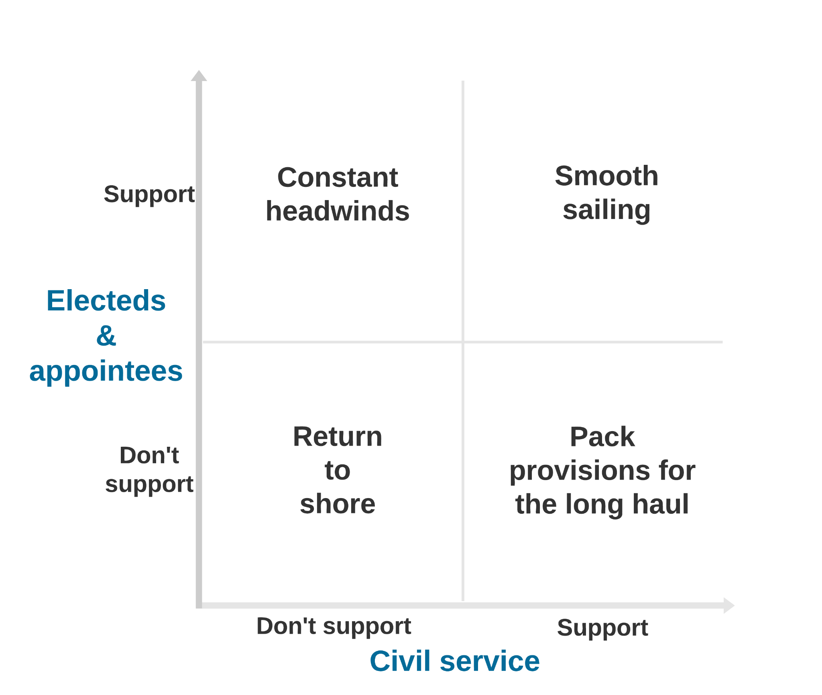
Diagnose alignment issues before setting sail

Slide 14

Institutional processes

Slide 15



A strategy that doesn’t engage the gears of government will evaporate on exit
Buying goods and services
Civil service management
Budget and funding

Slide 16
A strategy that doesn’t engage the gears of government will evaporate on exit
Contract vehicles for modern data tools and platforms
API requirements in standard contract terms
Model contracts for data services
Buying goods and services
Civil service management
Budget and funding

Slide 17
A strategy that doesn’t engage the gears of government will evaporate on exit
Buying goods and services
Civil service management
Redesign job classes for data roles
Develop screening guidance for HR staff
Model job descriptions
Budget and funding

Slide 18
A strategy that doesn’t engage the gears of government will evaporate on exit
Buying goods and services
Civil service management
Evaluation standards for program grants
Evidence standards for new budget requests
Budget and funding

Slide 19
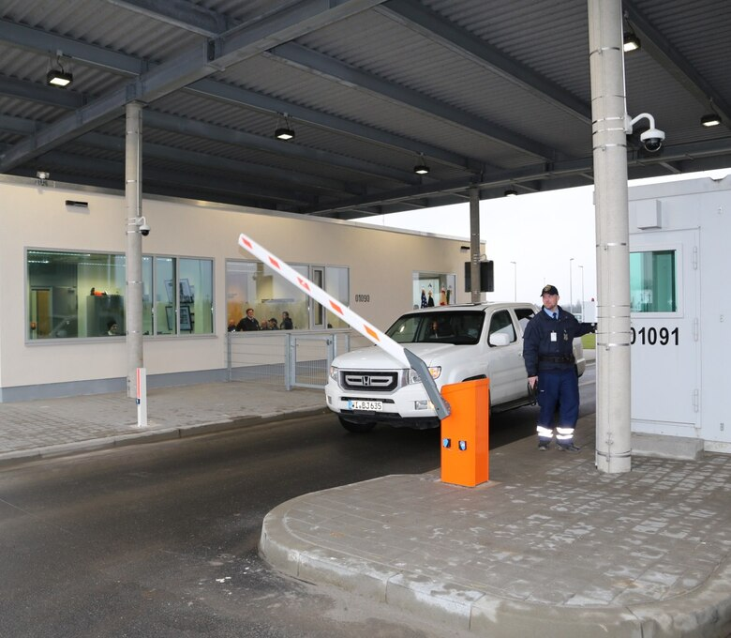
The art of rules and rule-making:
Aspirational policy versus control points

Slide 20

The art of rules and rule-making:
Policy windows open at confluence of problem saliency + viable policy + political will

Slide 21

Predicting pushback with the Wilson Lowi matrix

Slide 22
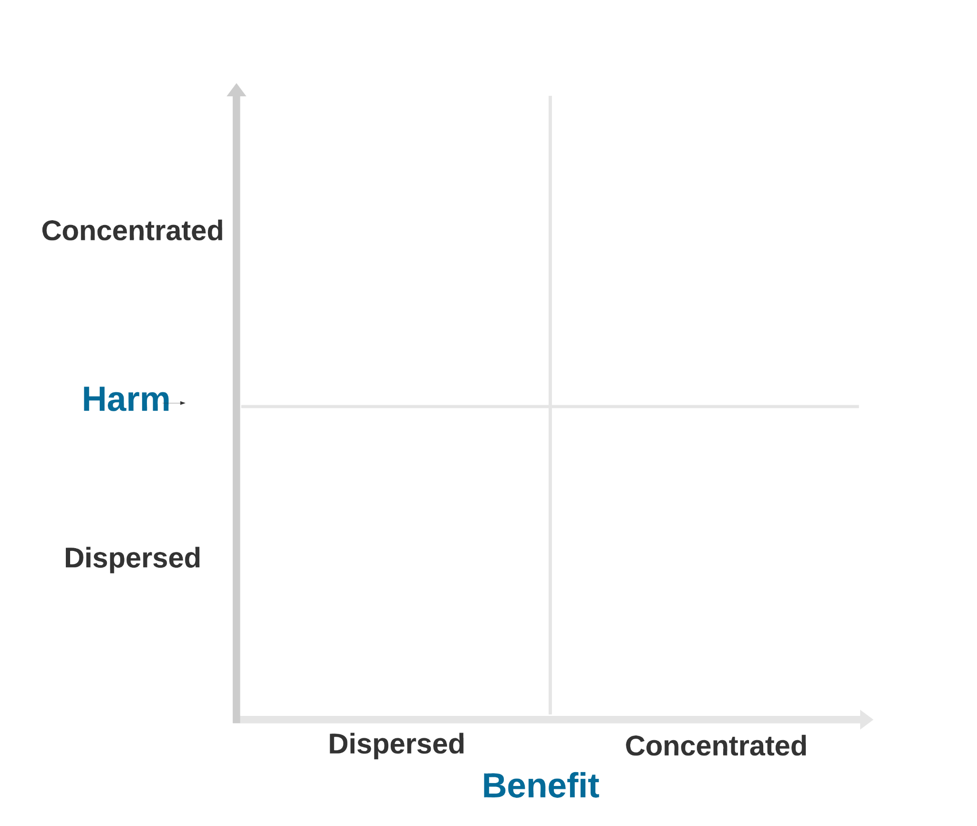
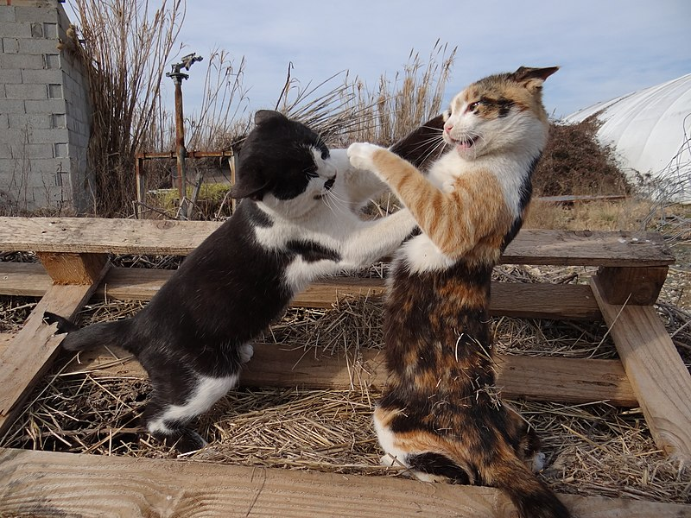


The concentration of impact predicts action
vs
Big money versus meh
(Ban tracking cookies)
Interest group cat fight
(DOD’s cloud platform)
People’s choice
(Set content standards)
Building gravy trains
(Getting 10Y contract)

Slide 23

Other plays

Slide 24

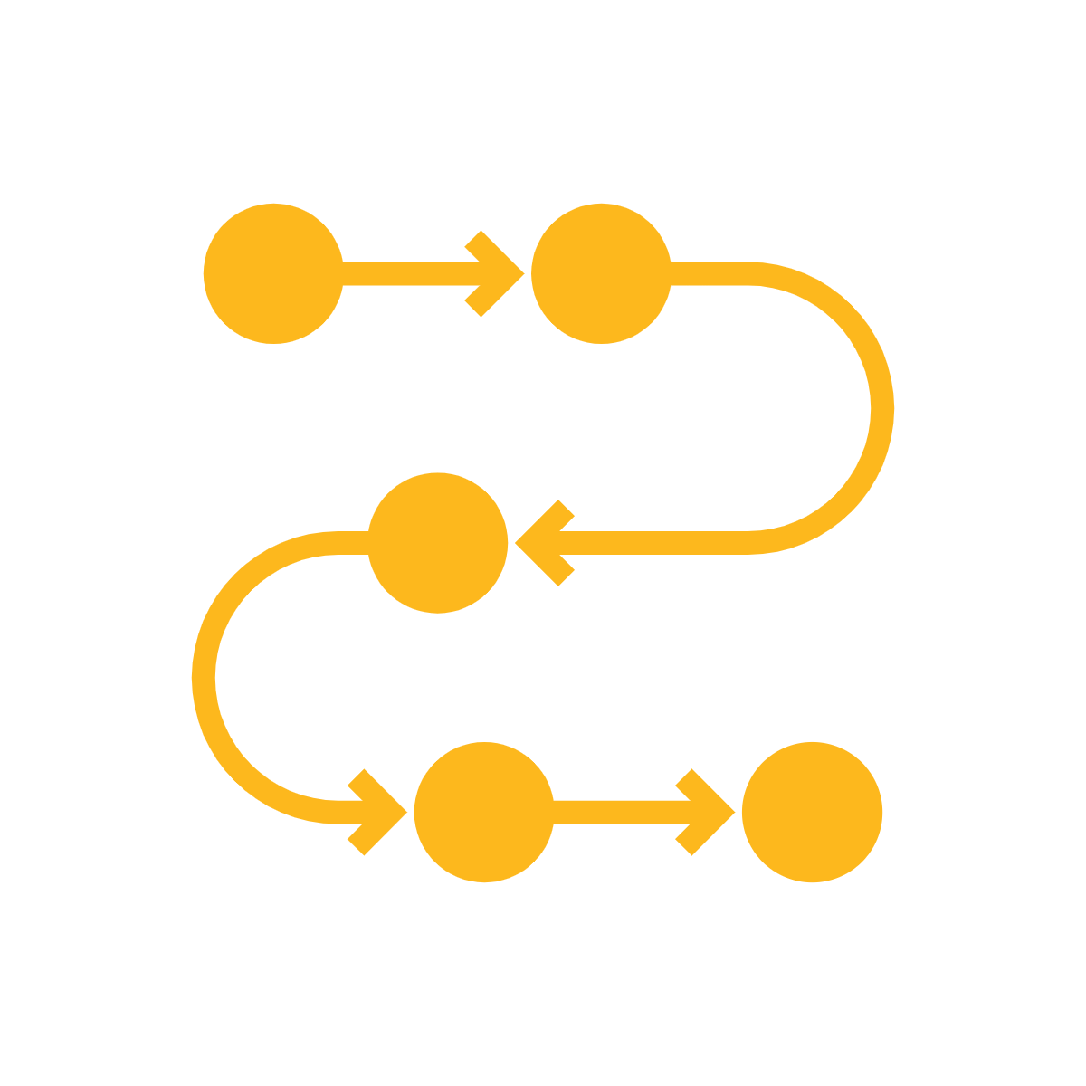
Procedural transparency is your friend

Slide 25


Use design to...
Direct the rider
Motivate the elephant
Shape the path

Slide 26
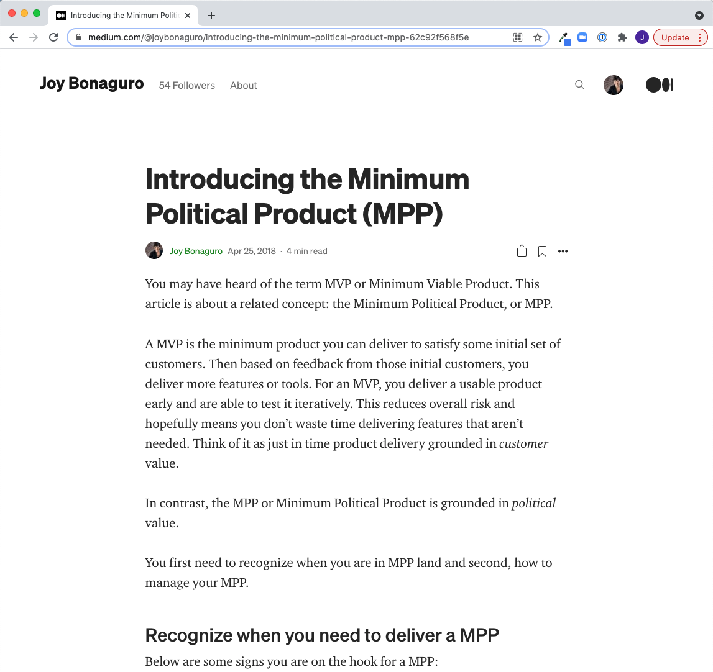
Identify your
MVPs
and manage appropriately

Slide 27
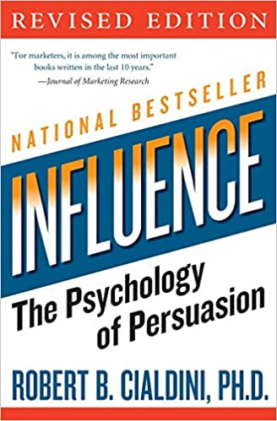
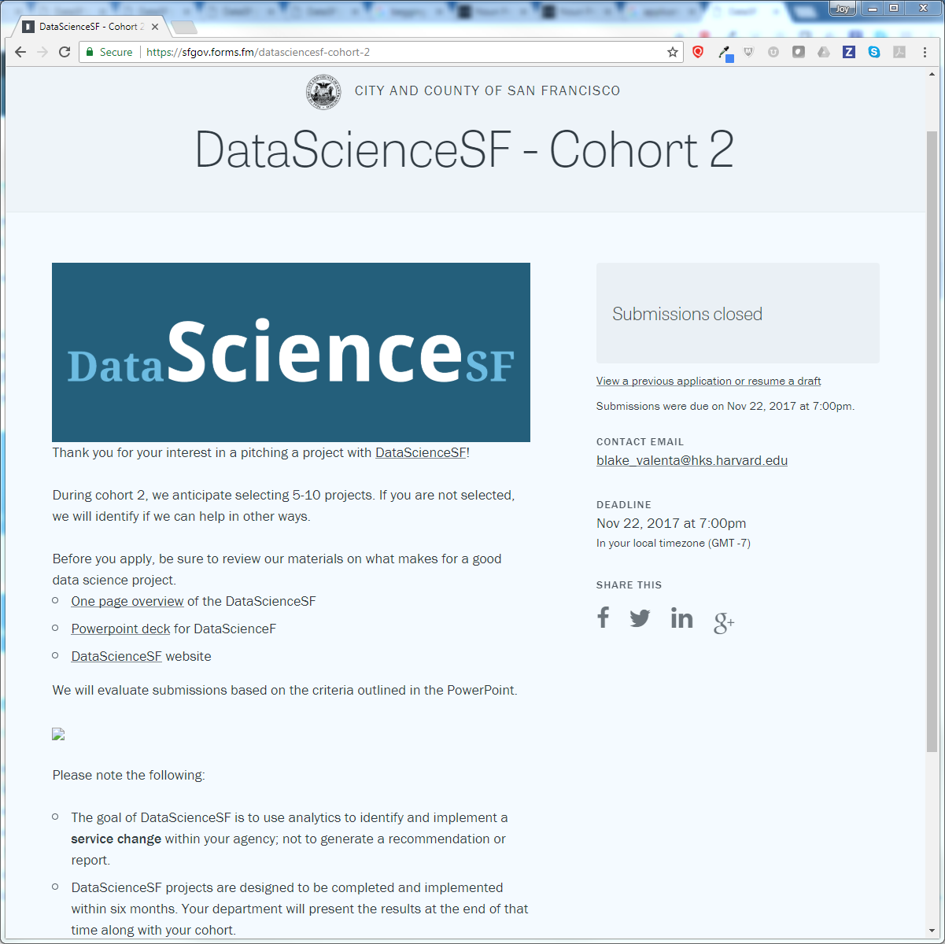

Invert power dynamics and foster scarcity by trying an application process
Notes:
Something about being chosen (selectivity), scarcity etc

Slide 28
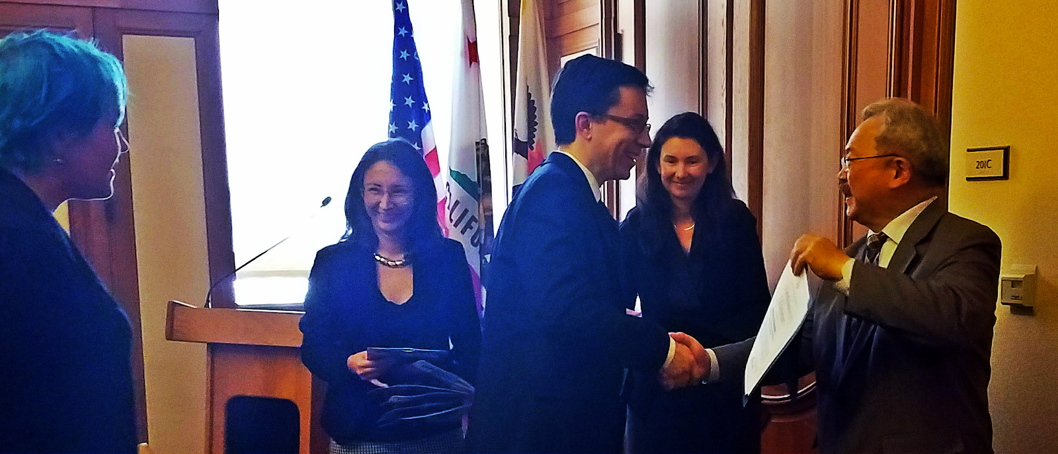
Use demo days and public recognition
to foster social proofing
Notes:
And this also leads to the

Slide 29

Design analogies to foster conceptual shortcuts
Data teams are the trainers
Business has to commit to getting in shape
IT maintains the gym

Slide 30



Slide 31
Change is hard. Choose work wisely.
Important
No Jerks
Lost
causes
Achievable
Work
here!
Battlegrounds
Diversions

Slide 32

We are here
MARK GARLICK/SCIENCE PHOTO LIBRARY

Slide 33

Thank you!
Questions / feedback / feelings / reactions / thoughts
welcome!
@joybonaguro | medium.com/@joybonaguro

